Slide 1
Session 4: Loops
C4T - Fundamentals

Slide 2
Previously on C4T
Variable

Slide 3
Variable

Slide 4
Variable
{variable_name} = {value}

Slide 5
Agenda
Turtle Introduction
For loops

Slide 6
Turtle Introduction

Slide 7
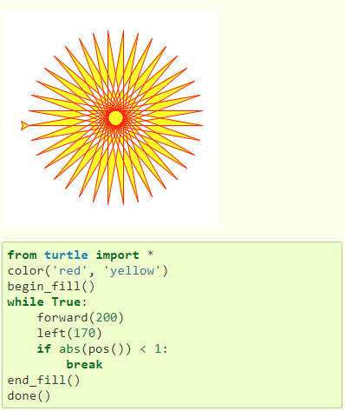
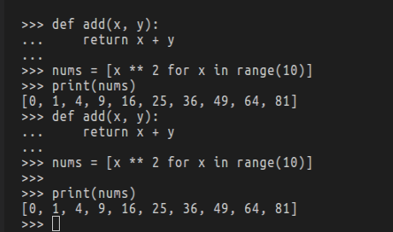
Turtle introduction

Slide 8
Turtle steps
Setup
Basic movements

Slide 9
Turtle setup
from turtle import *
mainloop()
<your code here>

Slide 10

Basic movements
forward(<distance>)

Slide 11

Basic movements
forward(<distance>)

Slide 12

Basic movements
forward(<distance>)

Slide 13

Basic movements
forward(<distance>)

Slide 14
Basic movements
backward(<distance>)

Slide 15

Basic movements
backward(<distance>)

Slide 16
Basic movements
left(<degree>)

Slide 17
Basic movements
left(<degree>)

Slide 18
Basic movements
right(<degree>)

Slide 19

Basics movements
right(<degree>)

Slide 20
import and mainloop explained
import
To use features that are not readily in place
mainloop()
To keep turtle from abruptly closing its window when all commands are finished

Slide 21
Square
90
90
90
90

Slide 22
Multi squares

Slide 23

Multi squares
RIGHT
LEFT

Slide 24
Multi squares
RIGHT
LEFT

Slide 25
Questions?
5 squares
10 squares
100 squares
1000 squares

Slide 26
Questions
YES
but NOT with Copy & Paste
We must use LOOP!!!

Slide 27
What is LOOP?
Allow programmers to repeat a task for as many times as they want
Just do practice and describe it yourself

Slide 28
For Loop

Slide 29
for
i
in
range(3)
:

Slide 30
Range

Slide 31
range(5) ~ [0, 1, 2, 3, 4]
range({stop})

Slide 32
range(1, 5) ~ [1, 2, 3, 4]
range({start}, {stop})

Slide 33
range(1, 5, 2) ~ [1, 3]
range({start}, {stop}, {step})

Slide 34
In

Slide 35
for i in range(4):
...

Slide 36
for i in [0, 1, 2, 3]:
...

Slide 37
for i in [0, 1, 2, 3]:
print(i)

Slide 38
for i in [0, 1, 2, 3]:
print(0)

Slide 39
for i in [0, 1, 2, 3]:
print(1)

Slide 40
for i in [0, 1, 2, 3]:
print(2)

Slide 41
for i in [0, 1, 2, 3]:
print(3)

